Slide 1
Feminist Approaches to Ethnology and Folklore
a collaborative annotated bibliography in progress
by the SIEF Working Group on Feminist Approaches

Slide 2
Why do we need an annotated bibliography?
There are no existing research tools for locating feminist scholarship in our fields.
Our educations probably fell short in this area.
So we are assembling the required reading for the seminar we never got to take—
—the one on feminist approaches to folklore and ethnology.

Slide 3
A centralized, accessible, searchable, exportable bibliography of feminist scholarship in folklore and ethnology will help us situate our own work and build on existing ideas.

Slide 4
So, a collection of pdfs?
No. This is a bibliographical database.
The Zotero tool (zotero.org) allows us to tag entries with keywords and to add abstracts.
Our aim is to annotate all entries with a short abstract outlining how the main ideas of the indexed work are relevant to the working group’s focus.

Slide 5
How to participate:
The database is here:
https://www.zotero.org/groups/4721914/feminist_approaches_to_ethnology_and_folklore
For access, contact Merrill Kaplan, the Curatrix: kaplan.103@osu.edu
Provide a permanent email address
  This will become your login to the Zotero database, so students and non-permanent faculty may wish to use a private email.
Expect a confirmation email. Go to Zotero.org and log in.

Slide 6
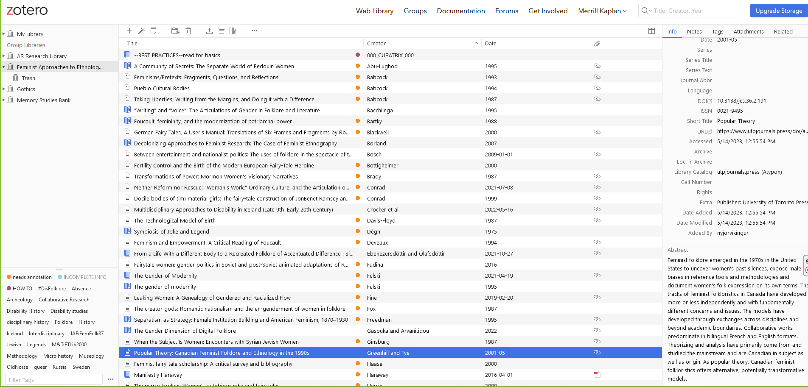
What you’ll see in the database:

Slide 7
Exported citation: Greenhill, Pauline, and Diane Tye. “Popular Theory: Canadian Feminist Folklore and Ethnology in the 1990s.” Journal of Canadian Studies, vol. 36, no. 2, May 2001, pp. 191–205, https://doi.org/10.3138/jcs.36.2.191.
Data pane
Abstract field
Notes:
Abstract field

Slide 8
Add new entries with “+” and enter data in right-hand pane
Add new item

Slide 9
Add new entries with “+” and enter data in right-hand pane
Add abstract: How is this article/book/chapter important as a feminist approach to folklore and ethnology?
Add new item

Slide 10
Some existing entries need annotations.
Let’s share these out among the membership. Go through the biblio and find one to annotate, so we can collectively get this info out.
In this way, no one does too much, and the work moves forward.
Please help work on the annotations

